Slide 1
CS 4974 Independent Study
9/22/22 meeting
Student: Bug Lee

Slide 2
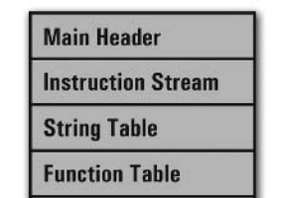
Last time, we discussed…
Code generation
Translating instruction stream, string, and function tables to VM specific bytecode.
Small demo for working assembler

Slide 3
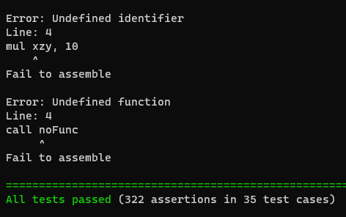
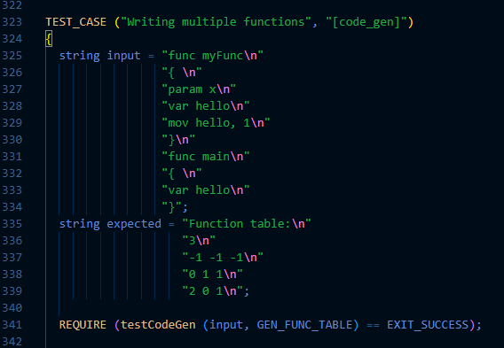
More Assembler Testing using C++ Catch2 framework

Slide 4
Week 4
compiler
assembler
script.source
script.assembly
script.executable
Virtual Machine
CPU

Slide 5
Simple
Virtual Machine

Slide 6
Virtual Machine structure
VM
Registers
Instruction stream
Runtime
Stack
Function
Table
String
Table

Slide 7
Registers
Instruction pointer (reserved for VM)
Frame pointer (reserved for VM)
Stack pointer (reserved for VM)
Return value

Slide 8
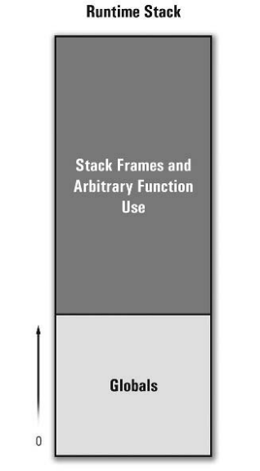
Runtime stack

Slide 9
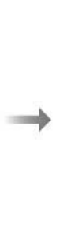
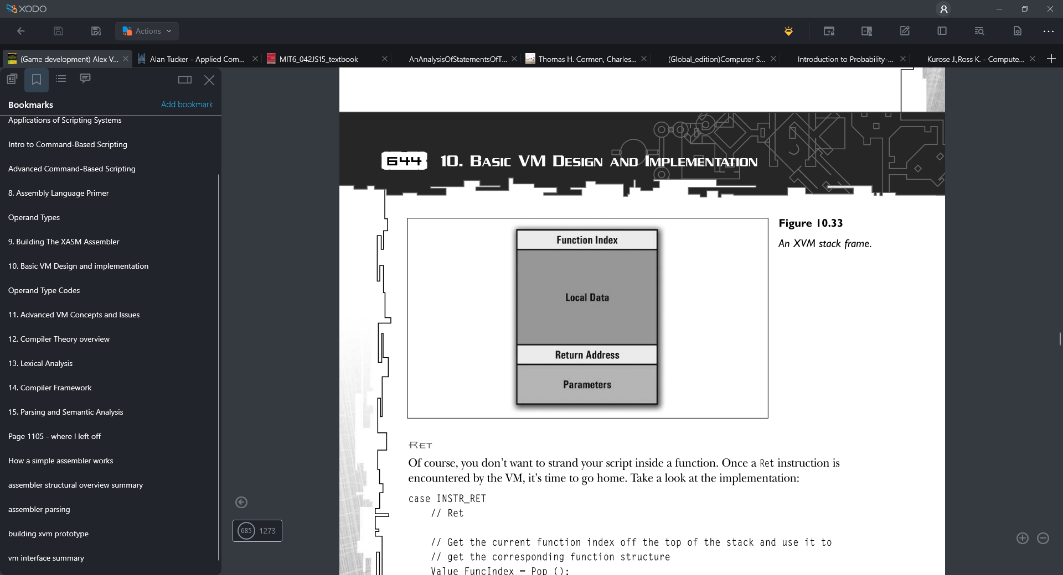
Stack Frame
{
Some other value
Frame pointer
Stack Frame for some function

Slide 10
VM
Binary file
Instruction stream
String Table
Function Table

Slide 11
Plan for week 5
Creating interface for resolving and coercing type
Goal of making Typeless language like Javascript
Creating interface for runtime stack and function table
Simpler stack frame management
Design and start implementing VM execution cycle

